Slide 1
Alaskan Wildlife
Capturing Nature with Your Lens

Slide 2
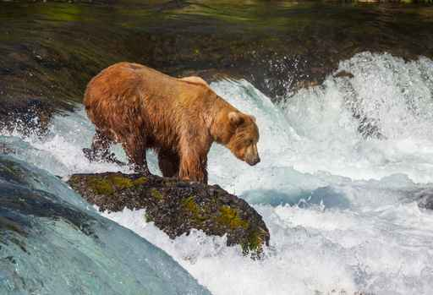
Be Careful
Use common sense
Never approach a real bear or bear cub
Your best pictures will be those in which you are not intruding on a wild animal’s home

Slide 3
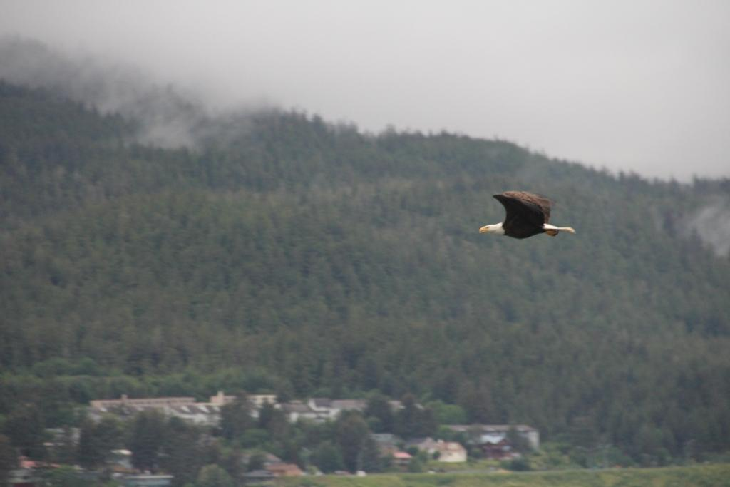
Lights, Camera, Action
Be prepared at all times with your camera. You will want to be ready if nature decides to fly right by you.

Slide 4
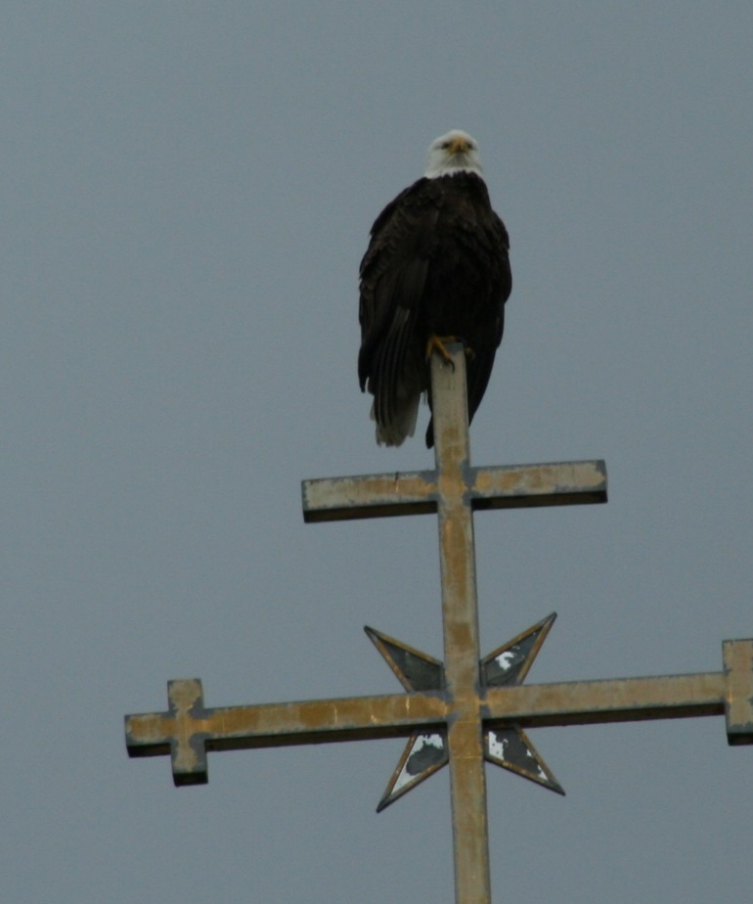
Be aware of the scenery
Look in all directions to find the best photographic opportunities

